Slide 1
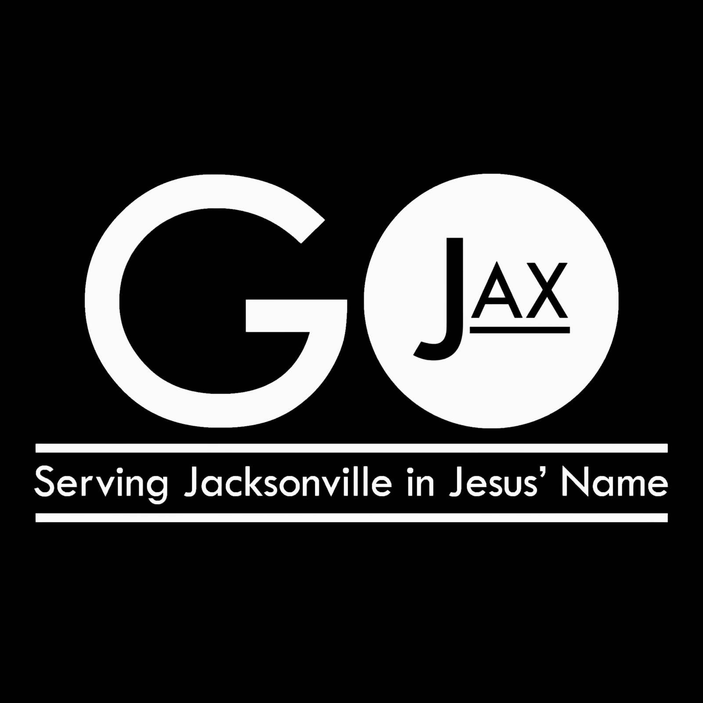
Saturday, October 3, 2026
www.gojax.net

Slide 2
GOJax is a day where churches throughout Jacksonville come together as one body to go out and serve our city.
Last year, 260 volunteers served at 16 different projects throughout the city, representing 25 different churches and community organizations!

